Slide 1


Home Insurance
Protecting Your Investment
JAVA BATCH - 1 / GROUP 3
Shyam Chandra
Sravya Surya Chaitanya Satya SaiNadh
Sasikala
Mentor: Nishi Verma

Slide 2


Abstract
The Home Insurance Automation System is a comprehensive web-based application designed to revolutionize the process of home insurance.
It addresses the inefficiencies of the current manual workflow by automating tasks related to obtaining, managing home insurance policies.
This system caters to both registered users and insurance agents, facilitating efficient policy management and delivering a superior user experience.
By this , We can reduce the use of manual paper-based Home Insurance which improves the accuracy and time consumption.

Slide 3
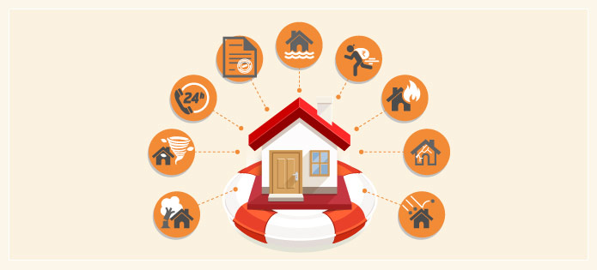
Introduction
In the Era of Home insurance , it is a web application using Spring boot replaces the traditional paper filling details to buy an insurance .
The goal of the application is to provide a dashboard to the insurance company where the user can buy the insurance policy. In this application the user needed to provide the Owner of the house details, Location details and property details to the Insurance company.
The employee will go through all the details given by user and will provide quote details to the user. If the user is satisfied with the quote, then he/she will proceed to buy the policy.
Since a lot of manual workflows is involved in this process, it takes a lot of time for employees to provide quotes as well as policies to the user.
So, by digital transformation the Home Insurance Automation System emerges as a beacon of innovation in the realm of home insurance .

Slide 4






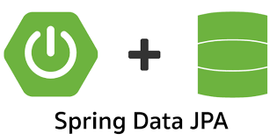
Technologies Used
Java - all the logics have been written in java.
MYSQL - used for storing and retrieving data.
Spring Boot - used to develop web applications.
Thymeleaf, CSS, Javascript - designing page layout.
JPA Repository - used for managing the data in a spring boot application.
Spring Security - used for authentication

Slide 5
Technologies Description
These technologies, when integrated effectively, enable the development of a secure, dynamic, and user-friendly Home Insurance Web Application. Thyme leaf and CSS handle the presentation layer, MySQL manages data storage, Spring MVC and JPA Repository handle application logic and data access, while Spring Security ensures the security of the application, making it a comprehensive solution.
Thyme leaf:
Thyme leaf is a server-side Java templating engine used for rendering dynamic HTML pages. It integrates seamlessly with Spring applications, allowing for the creation of dynamic and data-driven web pages.
CSS (Cascading Style Sheets):
CSS is a stylesheet language used for controlling the presentation and layout of web pages. It defines the visual style of web elements, such as fonts, colours, spacing, and responsiveness.

Slide 6
MySQL:
MySQL is an open-source relational database management system (RDBMS) that is widely used for storing and managing structured data. It provides robust data storage and retrieval capabilities.
Spring Boot :
Spring Boot is designed for beginners as well as professionals. Spring Boot, a module of the Spring framework, facilitates Rapid Application Development (RAD) capabilities.
JPA Repository (Java Persistence API Repository):
JPA is a Java specification for managing relational data in Java applications. A JPA repository, often used with Spring Data JPA, simplifies database operations by providing a high-level, object-oriented interface for data access.
Spring Security:
Spring Security is a robust framework for handling authentication and authorization in Java applications. It offers a wide range of features to secure web applications, including user authentication, role-based access control, and protection against common security threats.

Slide 7
Database Description
• A crucial component of any Home Insurance Web Application as it plays a pivotal role in storing, managing and retrieving the Data of the User. This section of the project report provides an overview of the database structure and its key elements.
• These database tables are created with the help of the JPA Repository interface.
•Sample JPA Repositories are @Table, @Id, @GenerateValue, @UniqueConstarint, etc.

Slide 8
Database Schema
Admin | User | Location Data | House Owner Data | Property Data
▪ Description: Stores information about admin details. ▪ Fields: ➢ Username - Admin Name ➢ password - Admin Password | ▪ Description: Stores information about User’s details. ▪ Fields: ➢ Id - User Id ➢ Username - User Name ➢ first name - User First Name ➢ Last name - User Last Name ➢ password - User Password | ▪ Description: Stores information about Location details. ▪ Fields: ➢ Residence Type - Location Residence Type ➢ Address 1 – Location Address line one ➢ Address 2 - Location Address line Two ➢ City – Location of the City ➢ Zip Code – City Zip Code ➢ Residence Use – Location Residence Use | ▪ Description: Stores information about House Owner’s details. ▪ Fields: ➢ first name - User First Name ➢ Last name - User Last Name ➢ Date of Birth - House Owner’s Date of Birth ➢ Retired- House Owner (Retired or Not) ➢ Security number – Security number of House Owner | ▪ Description: Stores information about Property details. ▪ Fields: ➢ Id - Property Id ➢ Market Value - Market value of the House ➢ Year – Year the House is built ➢ Square Footage – Square Feet of the House ➢ Dwelling Style– Type of Dwelling Style of the House ➢ Roof Material – Type of Roof Material ➢ Garage – Type of Garage ➢ Full Baths – Number of Full Baths ➢ Half Baths – Number of Half Baths

Slide 9

Scope of the Project
The scope of the Home Insurance System project encompasses the functional and non-functional requirements that define the boundaries and objectives of the system. It outlines the key components and functionalities that will be included in the project, as well as those that will be excluded .

Slide 10
Process Flow Diagram
Start
Login Page
New User Register
User login
Admin
Create
View All Users Policies/
Add New Policies
Retrieve Quote
Buy Policy

Slide 11

Process Flow
User Registration: The system will provide a user registration process to allow individuals to create accounts for accessing the Home Insurance System.
Getting a Quote: Users will be able to request insurance quotes by providing necessary information, such as location details, homeowner information, and property details.
Retrieving an Existing Quote: Users will have the capability to retrieve previously generated insurance quotes for reference and further action.
Buying a Policy: The system will support the purchase of insurance policies based on the provided quotes.
Viewing a Policy: Users can view the details of their purchased insurance policies, including coverage, premium, and effective dates.

Slide 12
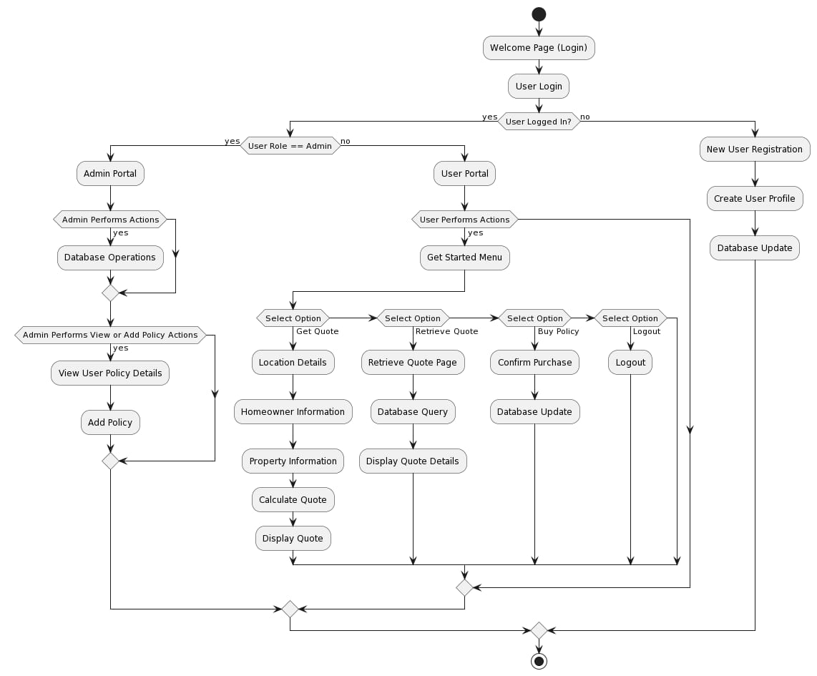
Architecture

Slide 13
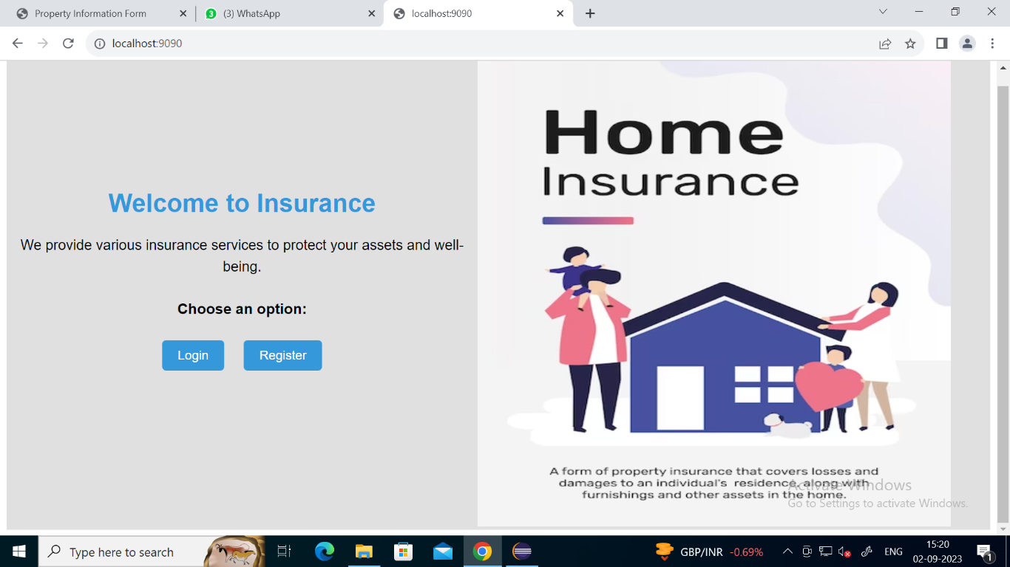
This is how our Welcome Page of the Home Insurance looks……

Slide 14
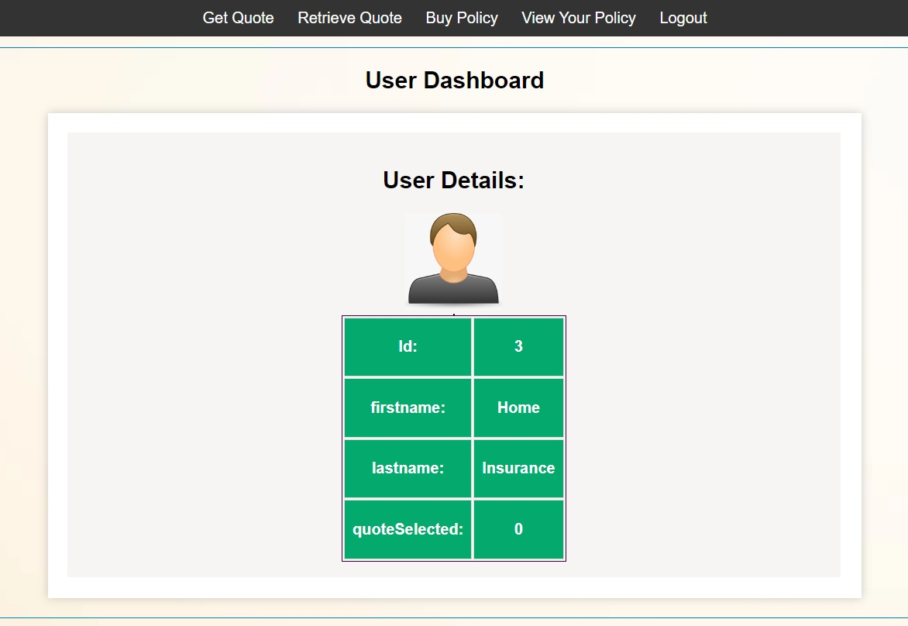
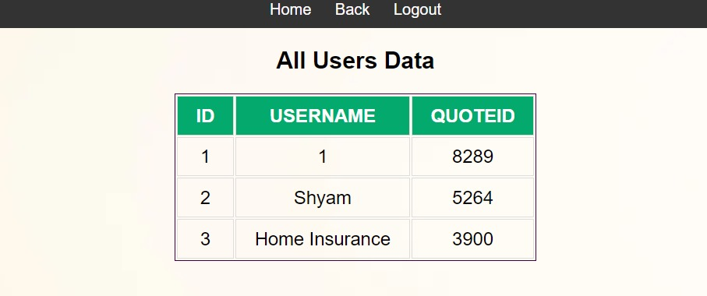
User DashBoard and Admin DashBoard

Slide 15
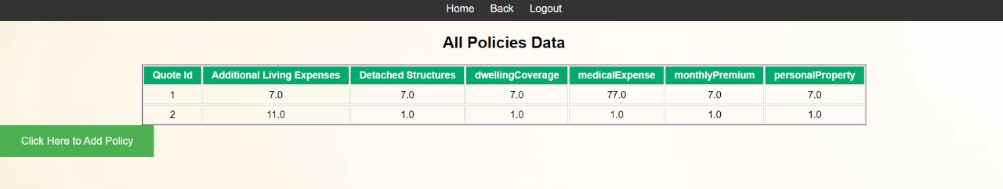
Add Policy and View Policies

Slide 16
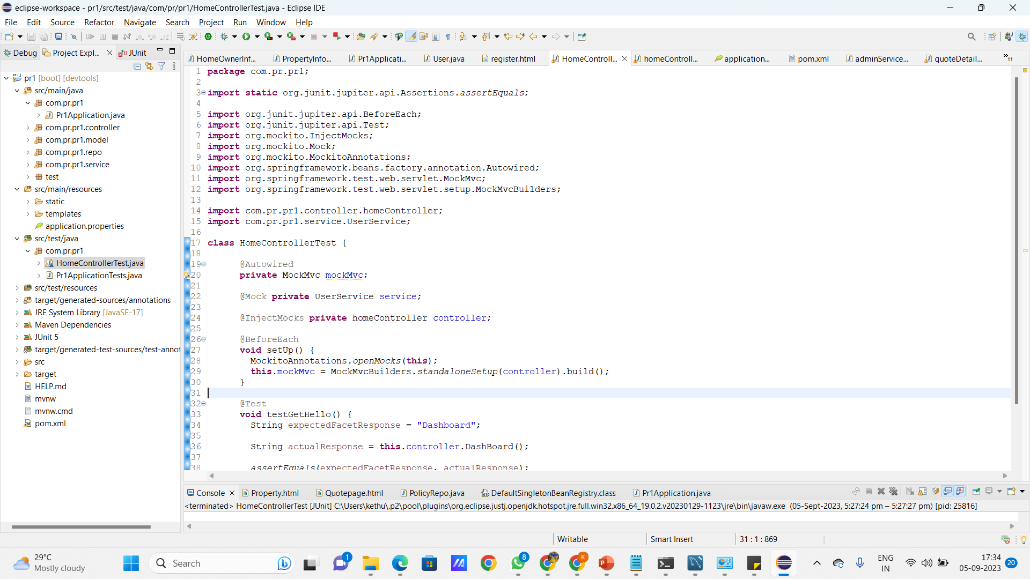
Test Results by JUnit

Slide 17

Conclusion
The Home Insurance System project aims to streamline the process of obtaining insurance quotes and policies, offering a more efficient and user-friendly experience. With a clear scope and well-defined objectives, we are confident that this project will bring numerous benefits to both users and the insurance company. As we move forward, the next steps include development and testing to ensure a successful implementation.

Slide 18

Future Scope
Phone and Mail Verification
Improvement of Security Problems
User-Friendly Interfaces
Invite Friends Through via Mail
Continuous Research

Slide 19


